Slide 1
Spanish Pic-Collage competition
Lo que como
TASK: Use the following prompts to create photo collages in Spanish and send them back to your teacher.
You can use any free apps and take your own pictures for ease of use. There will be Brookfield Rewards for the top five entries!
Prompts:
En mi nevera hay… (In my fridge there is…)
Mi fruta favorita es… (My favourite fruit is)
Para el desayuno como… (For breakfast I eat…)
Para el almuerzo como… (For lunch I eat…)
Ayer por la noche comí… (Yesterday evening I ate …)
Para mi próximo cumpleaños comeré... (For my next birthday I will eat…)
Normalmente bebo … (Normally, I drink…)
Me gusta comer… (I like to eat…)
Challenge:
Create your own prompts in Spanish!

Slide 2
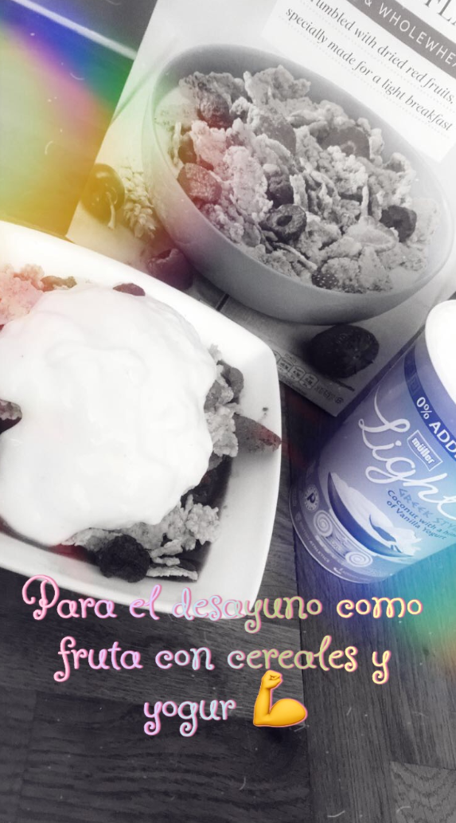
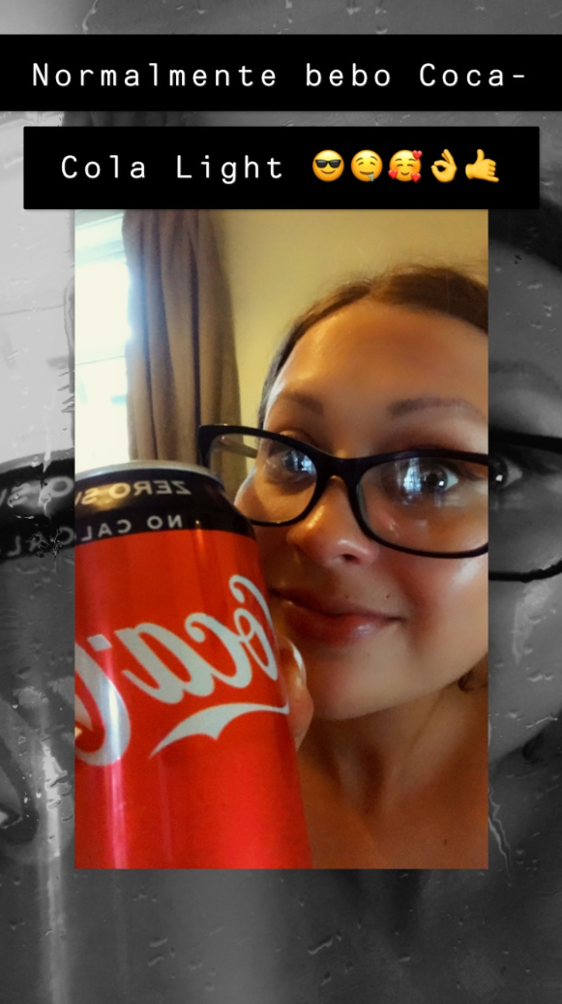
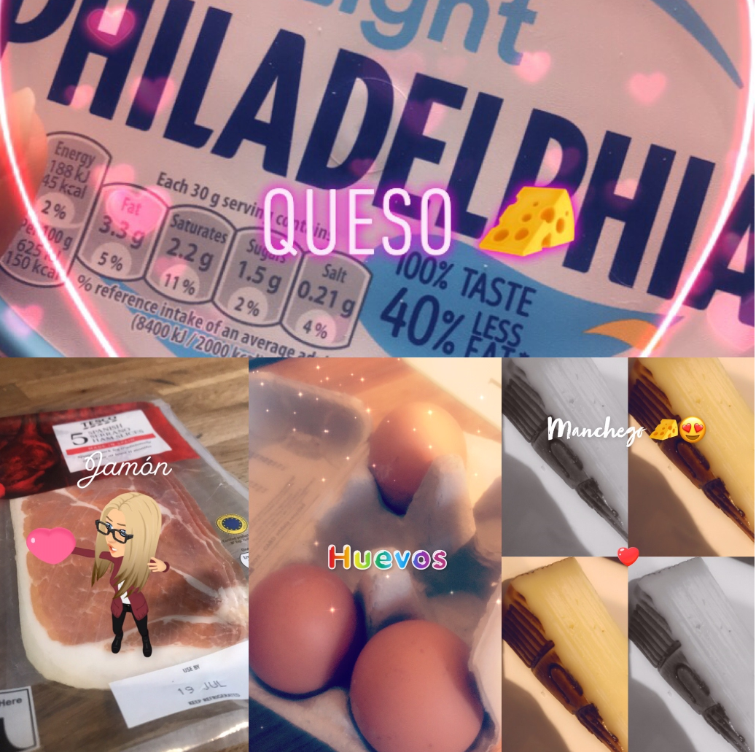
Example (You will need more photos than this for it to be a good collage!)

